Slide 1
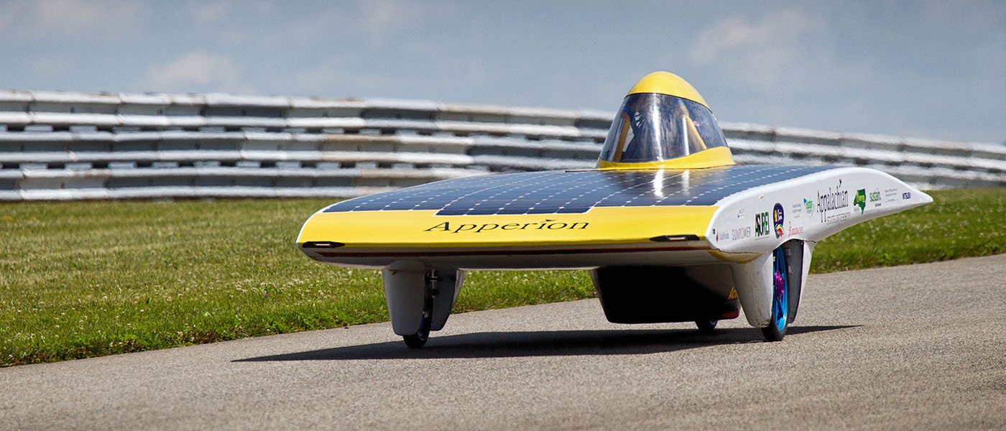
Light Solar Vehicles
Dr. John Martin
Appalachian State University
2019

Slide 3
ROSE (Racing on Solar Energy)
Appalachian State – Team Sunergy

Slide 11
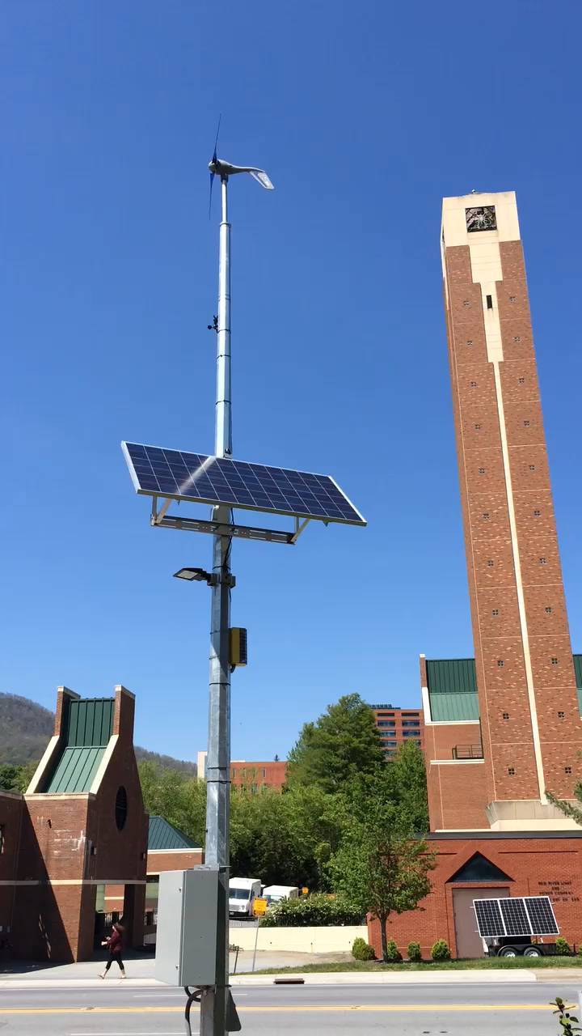
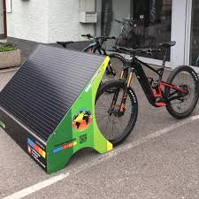

Slide 14
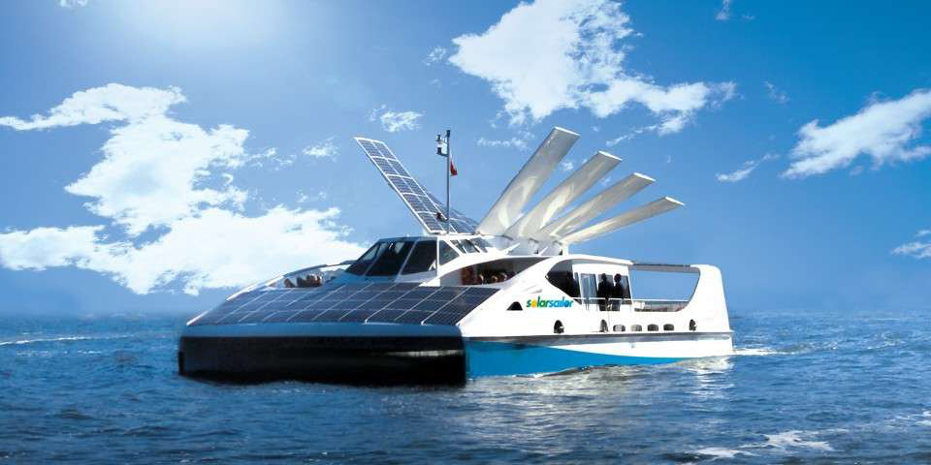

Slide 16
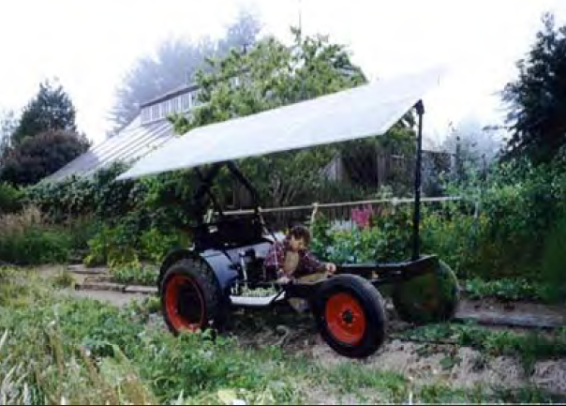

Slide 20
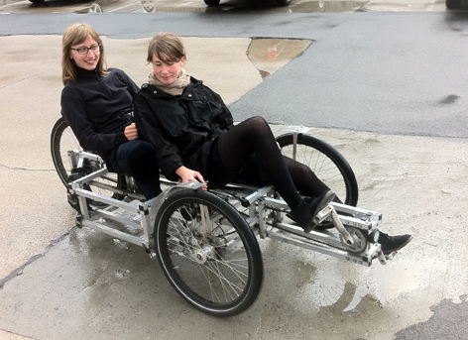
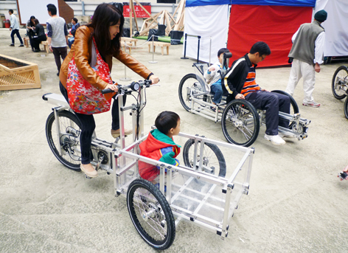
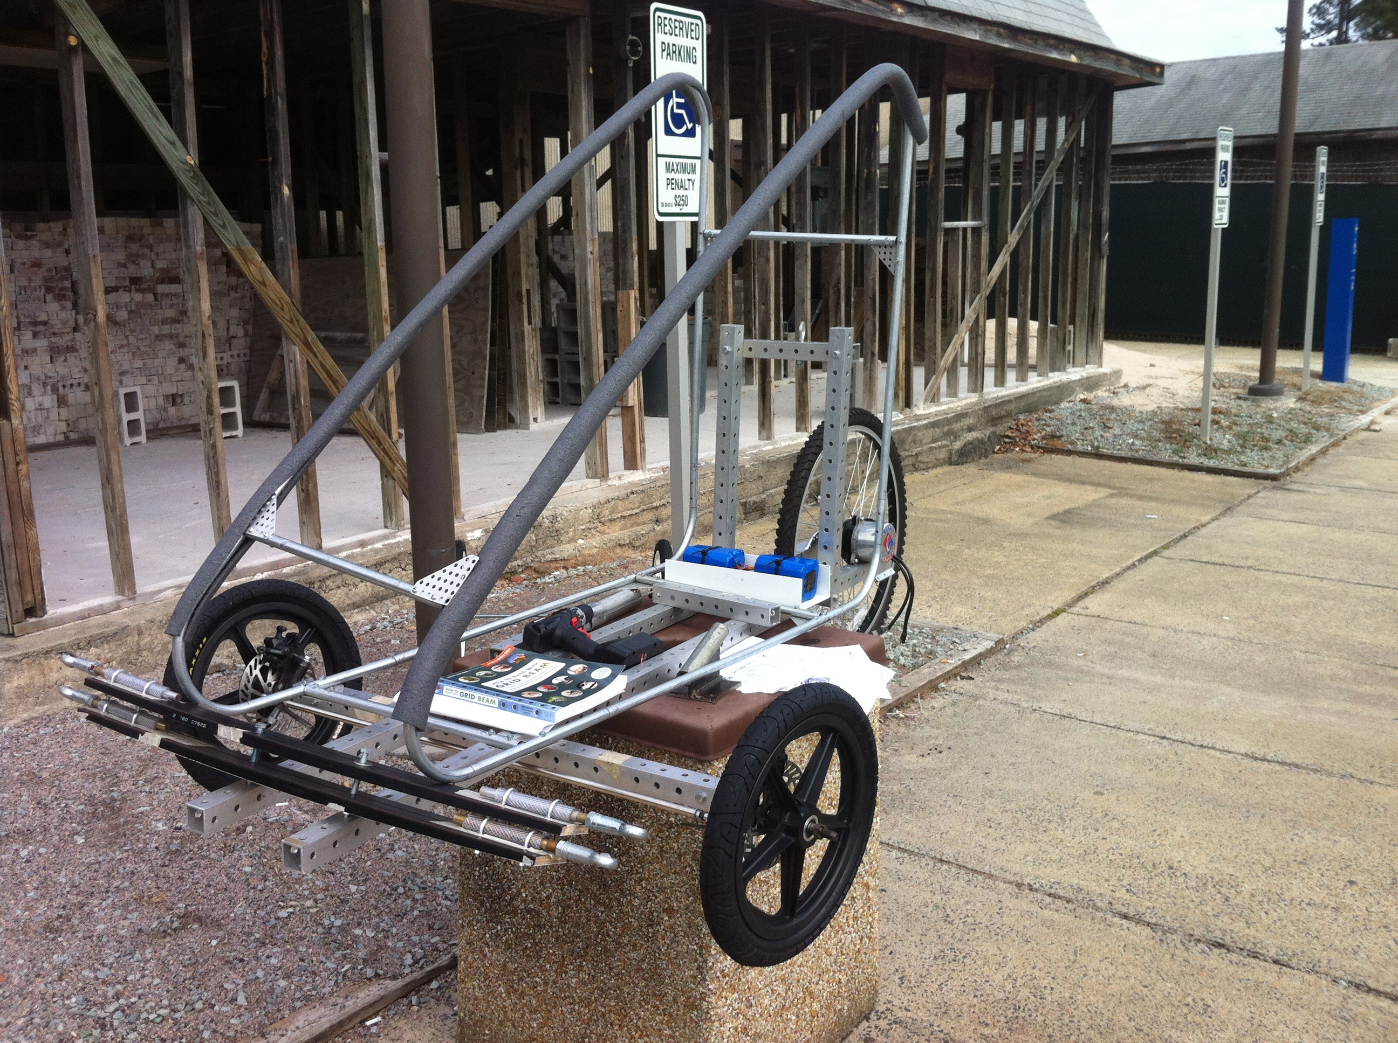

Slide 23
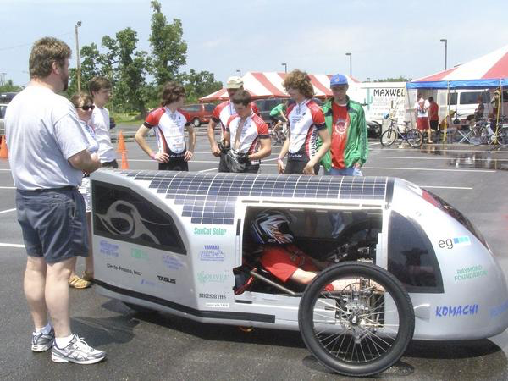

Slide 27
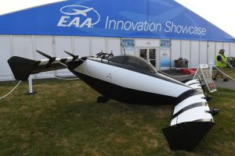

Slide 31
References:
Asu solar car https://today.appstate.edu/_images/_posts/2016/08/racing-the-sun/racing-the-sun-apperion.jpg
https://levassociation.com/tech-training/
www.teva-nc.org
Solar boats- web- https://www.treehugger.com/cars/7-awesome-solar-boats-you-must-see.html
grin technologies web- https://www.ebikes.ca
Solar tractors- web- http://www.tractor9.com/solar-tractors-for-agriculture.pdf
Solarbike rayce-web-http://www.speedace.info/solar_racing_events/solar_bike_rayce_usa.htm
https://www.thesuntrip.com/presentation/presentation-en/
3 video STEMcycle
video- https://www.youtube.com/watch?v=6o9Oj_XUXjQ
video- https://www.youtube.com/watch?v=dypTNc0ooY8&feature=youtu.be 20-2:20
2 FFR Outriderusa web- https://outriderusa.com
video- https://www.youtube.com/watch?v=ePU-aELIdwU
2 Organic Transit Elf web https://organictransit.com
video- https://www.youtube.com/watch?v=lhey6x8CRe8 9:55
Black Fly- web- https://www.opener.aero
Video-https://www.youtube.com/watch?v=jozITRIYLL4

